Slide 1
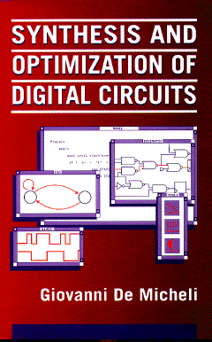


Two-level Logic Synthesis and Optimization
Giovanni De Micheli
Integrated Systems Centre
EPF Lausanne
This presentation can be used for non-commercial purposes as long as this note and the copyright footers are not removed
© Giovanni De Micheli – All rights reserved
Notes:
Page

Slide 2
Module 1
Objectives
  Fundamentals of logic synthesis
  Mathematical formulation
  Definition of the problems
(c) Giovanni De Micheli
Notes:
Page

Slide 3
Combinational logic design
Background
Boolean Algebra
  Quintuple (B, +, . , 0, 1)
  Binary Boolean algebra B = { 0, 1 }
Boolean function
  Single output f : B^{n} → B
  Multiple output f : B^{n} → B^{m}
  Incompletely-specified:
    Don’t care symbol: *
    f : B^{n} → { 0, 1, * }^{m}
(c) Giovanni De Micheli
Notes:
Page

Slide 4
The don’t care conditions
We do not care about the value of a function
Related to the environment
  Input patterns that never occur
  Input patterns such that some output is never observed
Very important for synthesis and optimization
(c) Giovanni De Micheli
Notes:
Page

Slide 5
Definitions
Scalar function:
  ON-set
    Subset of the domain such that f is true
  OFF-set
    Subset of the domain such that f is false
  DC-set
    Subset of the domain such that f is a don’t care
Multiple-output function:
  ON, OFF, DC-sets defined for each component
(c) Giovanni De Micheli
Notes:
Page

Slide 6
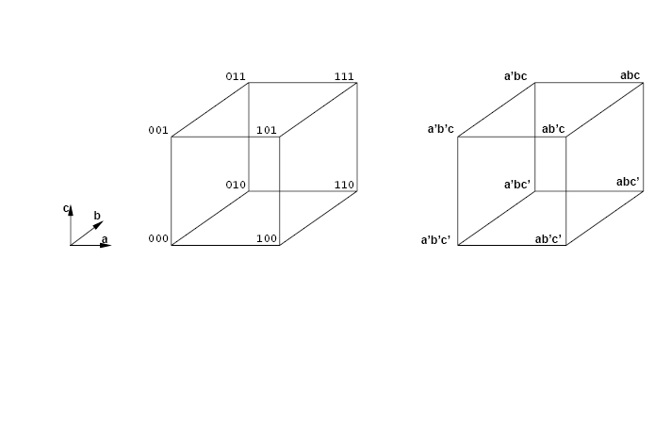
Cubical representation
(c) Giovanni De Micheli
Notes:
Page

Slide 7
Definitions
Boolean variables
Boolean literals:
  Variables and their complement
Product or cube:
  Product of literals
Implicant:
  Product implying a value of the function (usually 1)
  Hypercube in the Boolean space
Minterm:
  Product of all input variables implying a value of the function (usually 1)
  Vertex in the Boolean space
(c) Giovanni De Micheli
Notes:
Page

Slide 8
Tabular representations
Truth table
  List of all minterms of a function
Implicant table or cover
  List of implicants sufficient to define a function
Note
  Implicant tables are smaller in size as compared to truth tables
(c) Giovanni De Micheli
Notes:
Page

Slide 9
Example of truth table
x = ab+a’c; y = ab+bc+ac
abc | xy
000 | 00
001 | 10
010 | 00
011 | 11
100 | 00
101 | 01
110 | 11
111 | 11
(c) Giovanni De Micheli
Notes:
Page

Slide 10
Example of implicant table
x = ab+a’c; y = ab+bc+ac
abc | xy
001 | 10
*11 | 11
101 | 01
11* | 11
(c) Giovanni De Micheli
Notes:
Page

Slide 11
Cubical representation of minterms and implicants
f₁ = a’b’c’ + a’b’c + ab’c + abc +abc’
f₂ = a’b’c + ab’c
111
γ
β
101
β
101
001
δ
001
α
110
c
b
a
000
f1
f2
(c) Giovanni De Micheli
Notes:
Page

Slide 12
Representations
Visual representations
  Cubical notation
  Karnaugh maps
Computer-oriented representations
  Matrices
    Sparse
    Various encoding
  Binary-decision diagrams
    Address sparsity and efficiency
(c) Giovanni De Micheli
Notes:
Page

Slide 13
Module 2
Objectives
  Two-level logic optimization
  Motivation
  Models
  Exact algorithms for logic optimization
(c) Giovanni De Micheli
Notes:
Page

Slide 14
Two-level logic optimization motivation
Reduce size of the representation
Direct implementation
  PLAs reduce size and delay
Other implementation styles
  Reduce amount of information
  Simplify local functions and connections
(c) Giovanni De Micheli
Notes:
Page

Slide 15
Programmable logic arrays
Macro-cells with rectangular structure
  Implement any multi-output function
  Layout generated by module generators
  Fairly popular in the seventies/eighties
Advantages
  Simple, predictable timing
Disadvantages
  Less flexible than cell-based realization
  Dynamic operation
Open issue
  Will PLA structures be useful with new nanotechnologies? (e.g., nanowires)
(c) Giovanni De Micheli
Notes:
Page

Slide 16
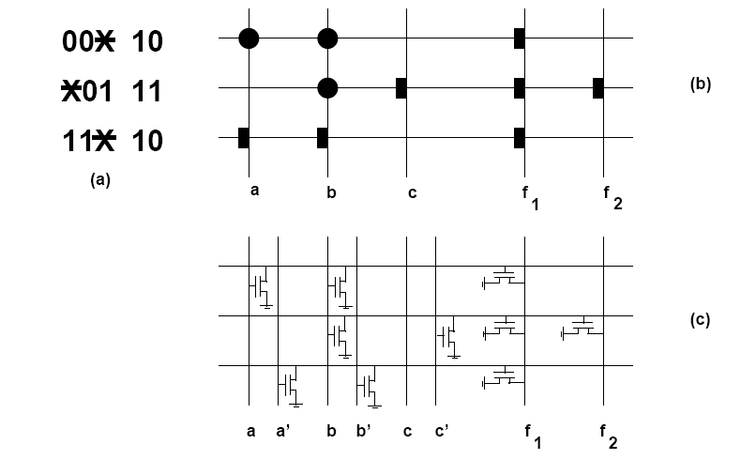
Programmable logic array
f₁ = a’b’ + b’c + ab; f₂ = b’c
(c) Giovanni De Micheli
Notes:
Page

Slide 17
Two-level minimization
Assumptions
  Primary goal is to reduce the number of implicants
  All implicants have the same cost
  Secondary goal is to reduce the number of literals
Rationale
  Implicants correspond to PLA rows
  Literals correspond to transistors
(c) Giovanni De Micheli
Notes:
Page

Slide 18
Definitions
Minimum cover
  Cover of a function with minimum number of implicants
  Global optimum
Minimal cover or irredundant cover
  Cover of the function that is not a proper superset of another cover
  No implicant can be dropped
  Local optimum
Minimal w.r.to 1-implicant containment
  No implicant contained by another one
  Weak local optimum
(c) Giovanni De Micheli
Notes:
Page

Slide 19
Example
f₁ = a’b’c’ + a’b’c + ab’c + abc +abc’; f₂ = a’b’c + ab’c
β
β
δ
Minimum cover
α
γ
β
δ
Irredundant cover
α
β
γ
β
δ
Minimal cover w.r. to single implicant containment
α
f1
f2
(c) Giovanni De Micheli
Notes:
Page

Slide 20
Definitions
Prime implicant
  Implicant not contained by any other implicant
Prime cover
  Cover of prime implicants
Essential prime implicant
  There exist some minterm covered only by that prime implicant
  Needs to be included in the cover
(c) Giovanni De Micheli
Notes:
Page

Slide 21
Two-level logic minimization
Exact methods
  Compute minimum cover
  Often difficult/impossible for large functions
  Based on Quine-McCluskey method
Heuristic methods
  Compute minimal covers (possibly minimum)
  Large variety of methods and programs
    MINI, PRESTO, ESPRESSO
(c) Giovanni De Micheli
Notes:
Page

Slide 22
Exact logic minimization
Quine’s theorem:
  There is a minimum cover that is prime
Consequence
  Search for minimum cover can be restricted to prime implicants
Quine-McCluskey method
  Compute prime implicants
  Determine minimum cover
(c) Giovanni De Micheli
Notes:
Page

Slide 23
Prime implicant table
Rows: minterms
Columns: prime implicants
Exponential size
  2^{n} minterms
  Up to 3^{n} / n prime implicants
Remarks
  Some functions have much fewer primes
  Minterms can be grouped together
  Implicit methods for implicant enumeration
(c) Giovanni De Micheli
Notes:
Page

Slide 24
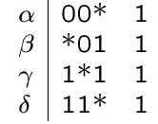
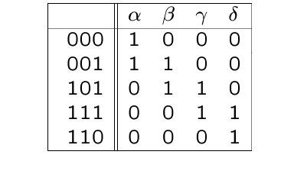
Example
f = a’b’c’ + a’b’c + ab’c +abc +abc’
Primes:
Table:
β
γ
δ
α
Prime implicants of f
β
δ
α
Minimum cover of f
(c) Giovanni De Micheli
Notes:
Page

Slide 25
Minimum cover early methods
Reduce table
  Iteratively identify essentials,
  save them in the cover.
  Remove covered minterms
Petrick’s method
  Write covering clauses in pos form
  Multiply out pos form into sop form
  Select cube of minimum size
Remark
  Multiplying out clauses has exponential cost
(c) Giovanni De Micheli
Notes:
Page

Slide 26
Example
pos clauses
  (α) (α + β) (β + γ) (γ + δ) (δ) = 1
sop form:
  αβδ + αγδ = 1
Solutions:
{ α β δ }
{ α γ δ }
β
γ
δ
α
(c) Giovanni De Micheli
Notes:
Page

Slide 27
Matrix representation
View table as Boolean matrix: A
Selection Boolean vector for primes: x
Determine X such that
  A x ≥ 1
  Select enough columns to cover all rows
Minimize cardinality of x
(c) Giovanni De Micheli
Notes:
Page

Slide 28
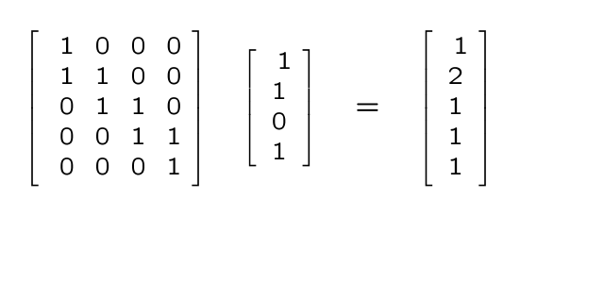
Example
(c) Giovanni De Micheli
Notes:
Page

Slide 29
Covering problem
Set covering problem:
  A set S -- minterm set
  A collection C of subsets (implicant set)
  Select fewest elements of C to cover S
Computationally intractable problem
Exact solution method
  Branch and bound algorithm
Several heuristic approximation methods
(c) Giovanni De Micheli
Notes:
Page

Slide 30
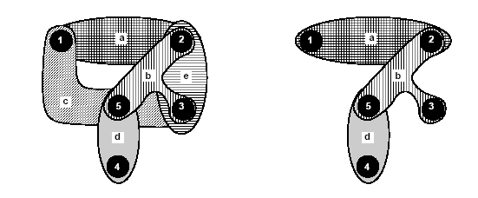
Example
Edge-cover of a hypergraph
(c) Giovanni De Micheli
Notes:
Page

Slide 31
Branch and bound algorithm
Tree search in the solution space
  Potentially exponential
Use bounding function:
  If the lower bound on the solution cost that can be derived from a set of future choices exceeds the cost of the best solution seen so far, then kill the search
  Bounding function should be fast to evaluate and accurate
Good pruning may expedite the search
(c) Giovanni De Micheli
Notes:
Page

Slide 32
Example
r
Bound = 6
Kill sub-tree
a
b
x
y
w
z
5
4
9
8
(c) Giovanni De Micheli
Notes:
Page

Slide 33
Branch and bound for logic minimization
Reduction strategies
Use matrix formulation of the problem
Partitioning:
  If A is block diagonal:
    Solve covering problems for the corresponding blocks
Essentials
  Column incident to one (or more) rows with single 1
    Select column
    Remove covered row(s) from table
(c) Giovanni De Micheli
Notes:
Page

Slide 34
Branch and bound for logic minimization
Reduction strategies
Column (implicant) dominance:
  If a_{ki} ≥ a_{kj} for all k
    Remove column j (dominated)
  Dominated implicant ( j ) has its minterms already covered by dominant implicant ( i )
Row (minterm) dominance:
  If a_{ik} ≥ a_{jk} for all k
    Remove row i (dominant)
  When an implicant covers the dominated minterm, it also covers the dominant one
(c) Giovanni De Micheli
Notes:
Page

Slide 35
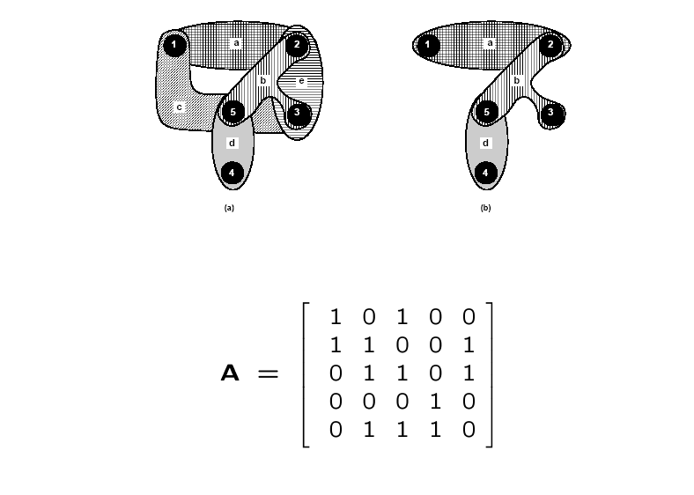
Example
(c) Giovanni De Micheli
Notes:
Page

Slide 36
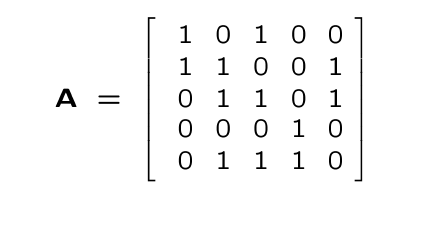
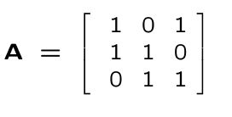
Example
Fourth column is essential
Fifth column is dominated
Fifth row is dominant
Matrix after reductions:
(c) Giovanni De Micheli
Notes:
Page

Slide 37
Branch and bound covering algorithm
EXACT_COVER(A,x,b) {
Reduce matrix A and update corresponding x;
if (current_estimate ≥ |b|) return (b);
if (A has no rows) return(x);
select a branching column c;
x_{c} = 1;
Ã = A after deleting c and rows incident to it;
x~ = EXACT_COVER(Ã,x,b);
if ( | x~| < |b| )
b = x~;
x_{c} = 0;
Ã = A after deleting c;
x~ = EXACT_COVER(Ã,x,b);
if ( | x~| < |b| )
b = x~;
return(b);
}
(c) Giovanni De Micheli
Notes:
Page

Slide 38
Bounding function
Estimate lower bound on covers that can be derived from current solution vector x
The sum of the 1s in x, plus bound of cover for local A
  Independent set of rows
    No 1 in the same column
    Require independent implicants to cover
  Construct graph to show pairwise independence
  Find clique number
    Size of the largest clique
  Approximation (lower) is acceptable
(c) Giovanni De Micheli
Notes:
Page

Slide 39
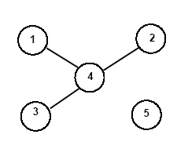
Example
Row 4 independent from 1,2,3
Clique number and bound is 2
(c) Giovanni De Micheli
Notes:
Page

Slide 40
Example
There are no independent rows
  Clique number is 1 (one vertex)
  Bound is 1+1= 2
    Because of the essential already selected
  0 1
  1 1 0
  0 1 1
A =
(c) Giovanni De Micheli
Notes:
Page

Slide 41
Example
Branching on the cyclic core
Select first column
  Recur with Ã = [11]
    Delete one dominated column
    Take other column (essential)
  New cost is 3
Exclude first column
  Find another solution with cost equal to 3.
  Discard
  0 1
  1 1 0
  0 1 1
A =
(c) Giovanni De Micheli
Notes:
Page

Slide 42
Espresso-exact
Exact 2-level logic minimizer
Exploits iterative reduction and branch and bound algorithm on cyclic core
Compact implicant table
  Rows represent groups of minterms covered by the same implicants
Very efficient
  Solves most benchmarks
(c) Giovanni De Micheli
Notes:
Page

Slide 43
Example
After removing the essentials
0111
α 0 * * 0 1
1011
β * 0 * 0 1
0110
γ 0 1 * * 1
 | α | β | ε | ζ
0000,0010 1101 | 1 0 | 1 0 | 0 1 | 0 1
1010
0010
δ 1 0 * * 1
0100
ε 1 * 0 1 1
0000
1101
ζ * 1 0 1 1
0101
1001
c
b
d
a
(c) Giovanni De Micheli
Notes:
Page

Slide 44
Exact two-level minimization
There are two main difficulties:
  Storage of the implicant table
  Solving the cyclic core
Implicit representation of prime implicants
  Methods based on binary decision diagrams
  Avoid explicit tabulation
Recent methods make 2-level optimization solve exactly almost all benchmarks
  Heuristic optimization is just used to achieve solutions faster
(c) Giovanni De Micheli
Notes:
Page

Slide 45
Module 3
Boolean Relations
  Motivation of using relations
  Optimization of realization of Boolean relation
  Comparisons to two-level optimization
(c) Giovanni De Micheli
Notes:
Page

Slide 46
Boolean relations
Generalization of Boolean functions
More than one output pattern may correspond to an input pattern
  Multiple-choice specifications
  Model inner blocks of multi-level circuits
Degrees of freedom in finding an implementation
  More general than don’t care conditions
Problem:
  Given a Boolean relation, find a minimum cover of a compatible Boolean function that can implement the relation
(c) Giovanni De Micheli
Notes:
Page

Slide 47
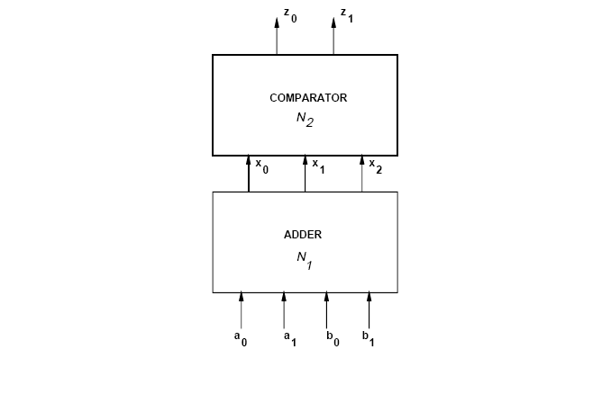
Example
Compare:
  a + b > 4 ?
  a + b < 3 ?
(c) Giovanni De Micheli
Notes:
Page

Slide 48
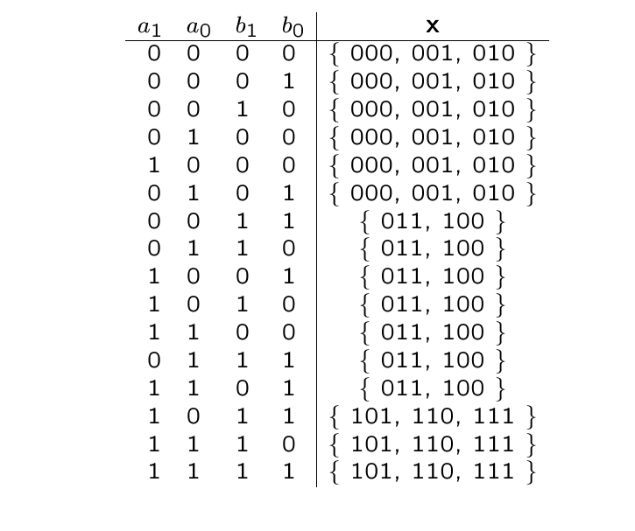
Example
(c) Giovanni De Micheli
Notes:
Page

Slide 49
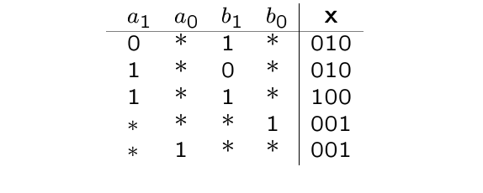
Example
Circuit is no longer an adder
(c) Giovanni De Micheli
Notes:
Page

Slide 50
Minimization of Boolean relations
Since there are many possible output values (for any input), there are many logic functions implementing the relation
  Compatible functions
Problem
  Find a minimum compatible function
Do not enumerate all compatible functions
  Compute the primes of the compatible functions
    C-primes
  Derive a logic cover from the c-primes
(c) Giovanni De Micheli
Notes:
Page

Slide 51
Binate covering
Covering problem is more complex
  As compared to minimizing logic functions.
In classic Boolean minimization we just need enough implicants to cover the minterm
  Covering clause is unate in all variables
  Any additional implicant does not hurt
In Boolean relation optimization, we need to pick implicants to realize a compatible function
  Some implicants cannot be taken together
  Covering clause is binate (implicant mutual exclusion)
  Non-compact Boolean space
(c) Giovanni De Micheli
Notes:
Page

Slide 52
Solving binate covering
Binate cover can be solved with branch and bound
  In practice much more difficult to solve, because it is harder to bound effectively
Binate cover can be reduced to min-cost SAT
  SAT solvers can be used
Binate cover can be also modeled by BDDs
Several approximation algorithms for binate cover
(c) Giovanni De Micheli
Notes:
Page

Slide 53
Boolean relations
Generalization of Boolean functions
  More degrees of freedom than don’t care sets
Useful to represent multiple choice
Useful to model internals of logic networks
Elegant formalism, but computationally-intensive solution method
(c) Giovanni De Micheli
Notes:
Page

